Slide 1
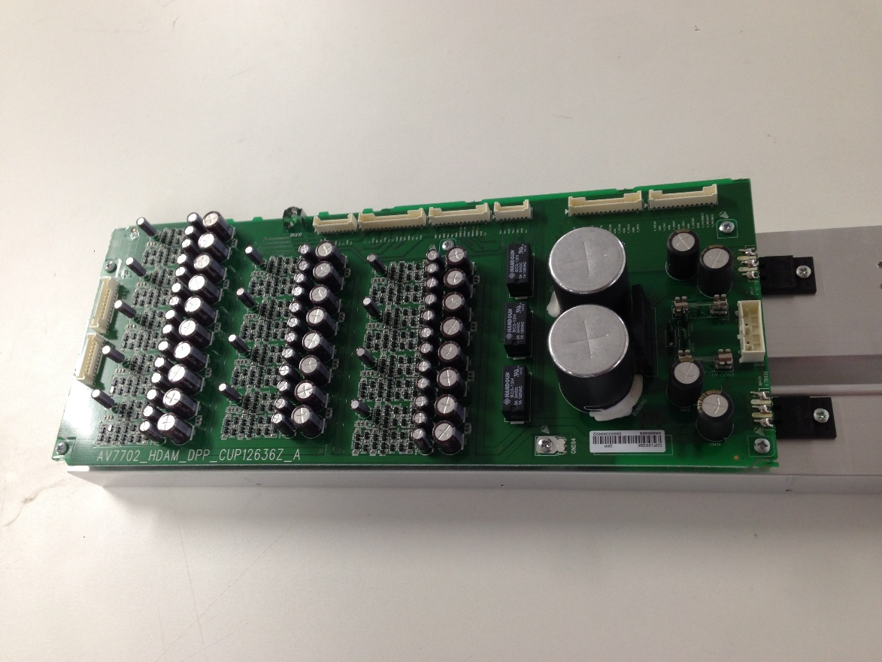
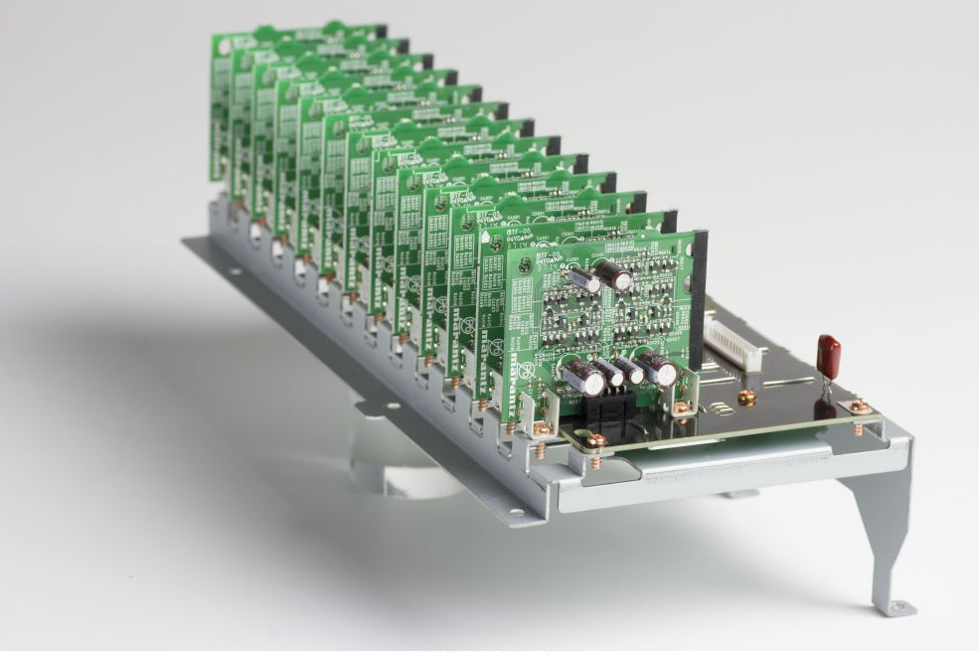
HDAM-Pure Lines (7702 Versus the 8802)
AV7702: Pre-AMP PCB (for 13ch)
AV8802: Pre-AMP PCB (for 13ch)

Slide 2
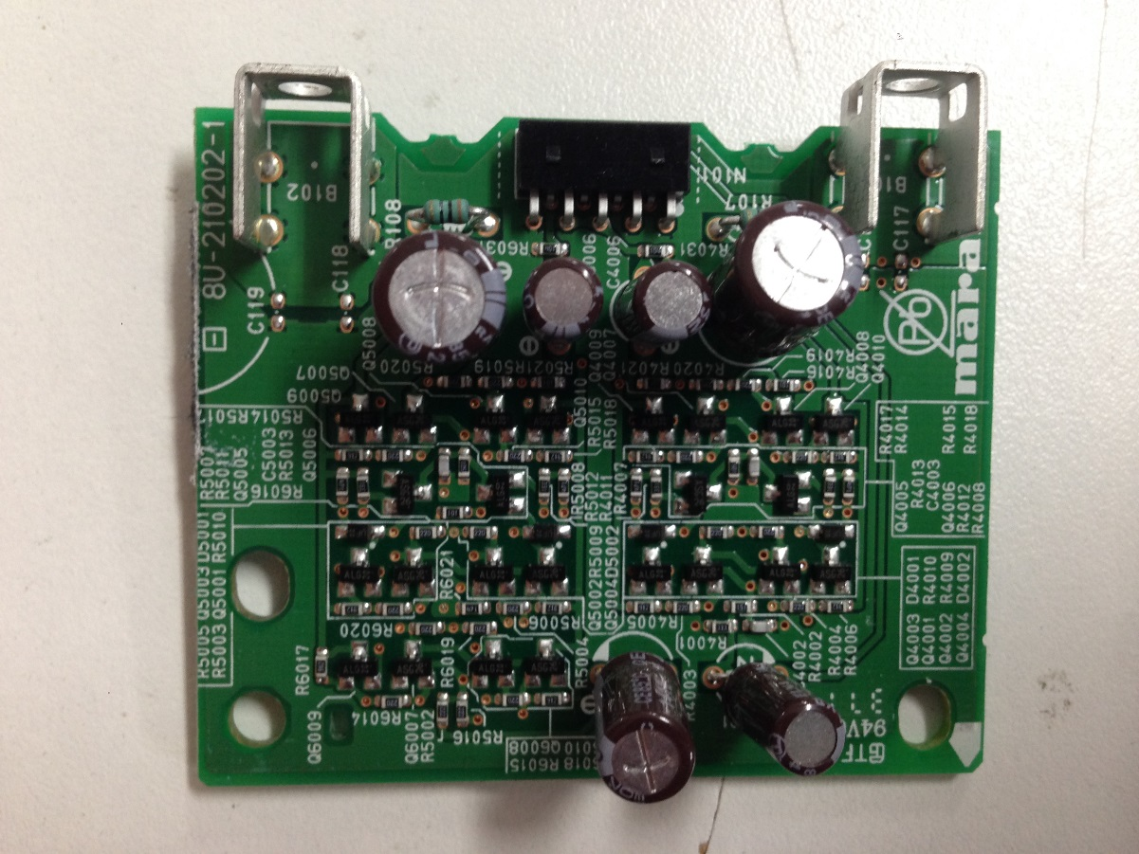
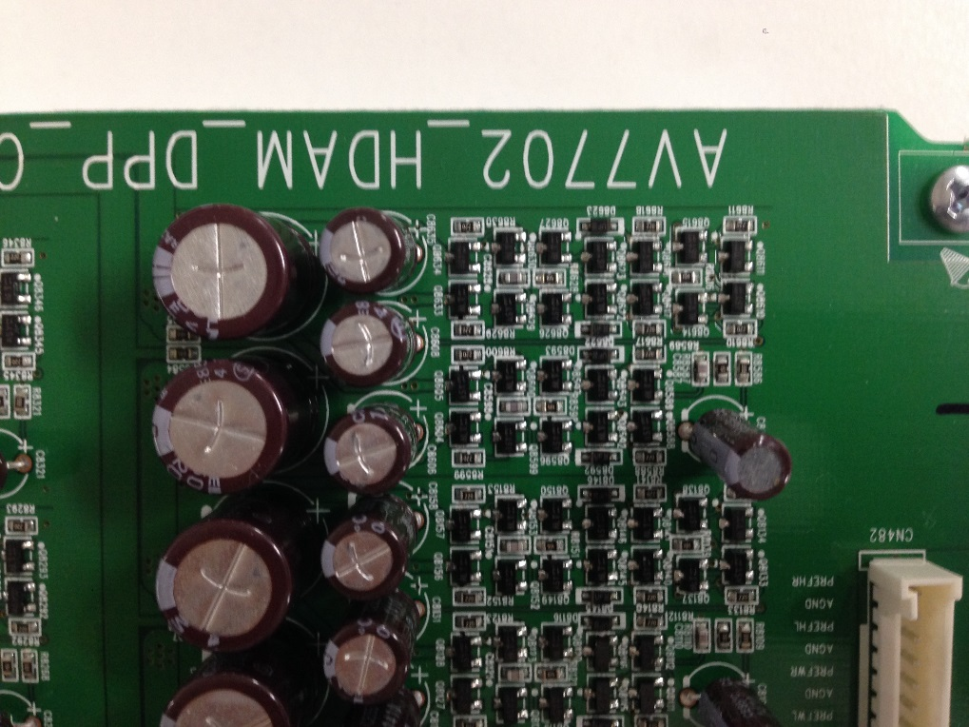
HDAM-Pure Lines (7702 Layout Versus 8802)
AV7702: Pre-AMP PCB (for 1ch)
AV8802: Pre-AMP PCB (for 1ch)

Slide 3
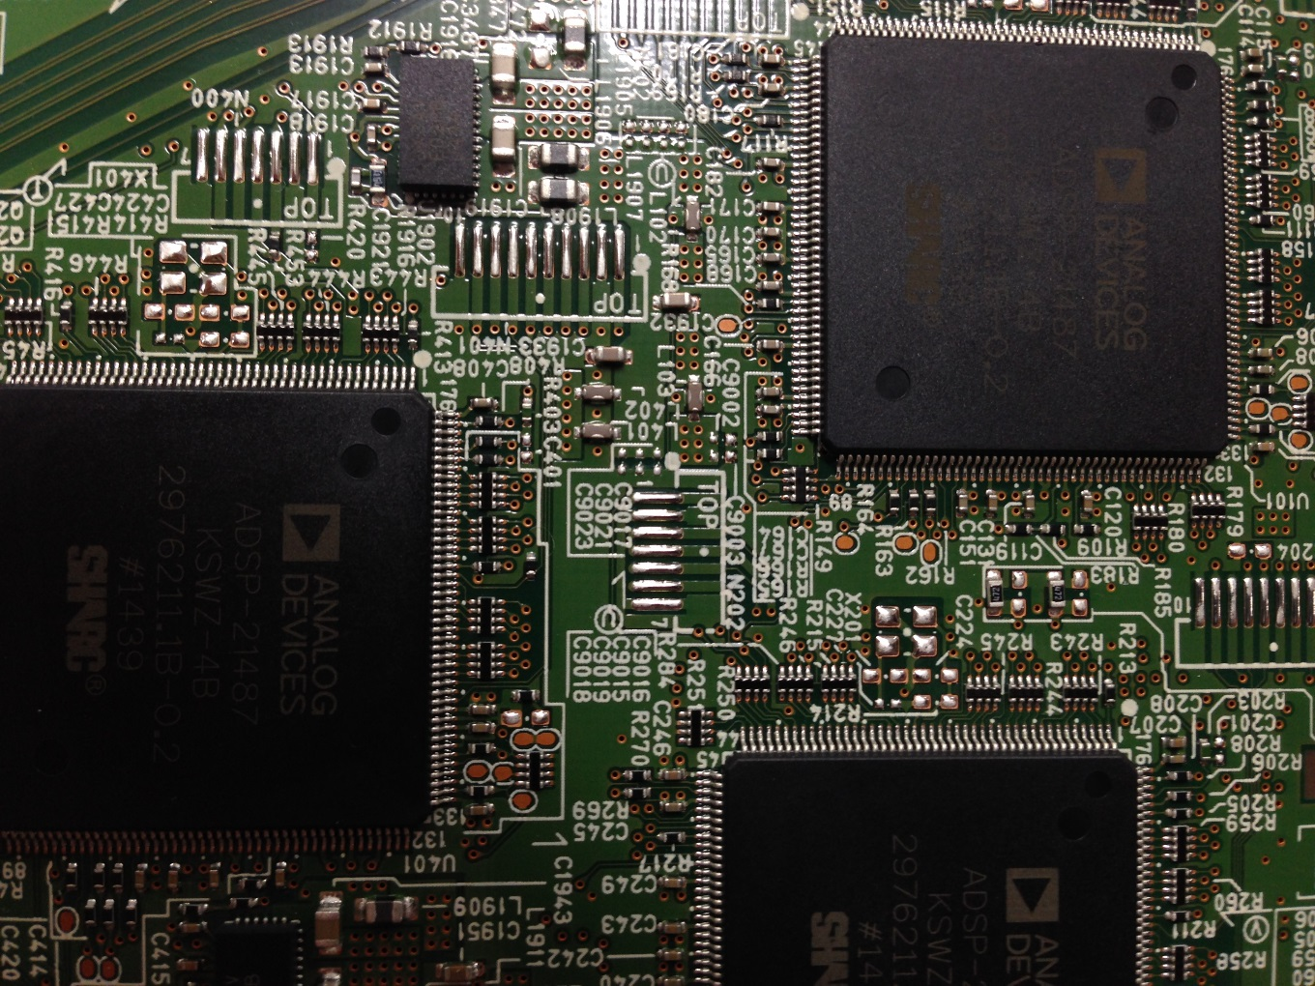
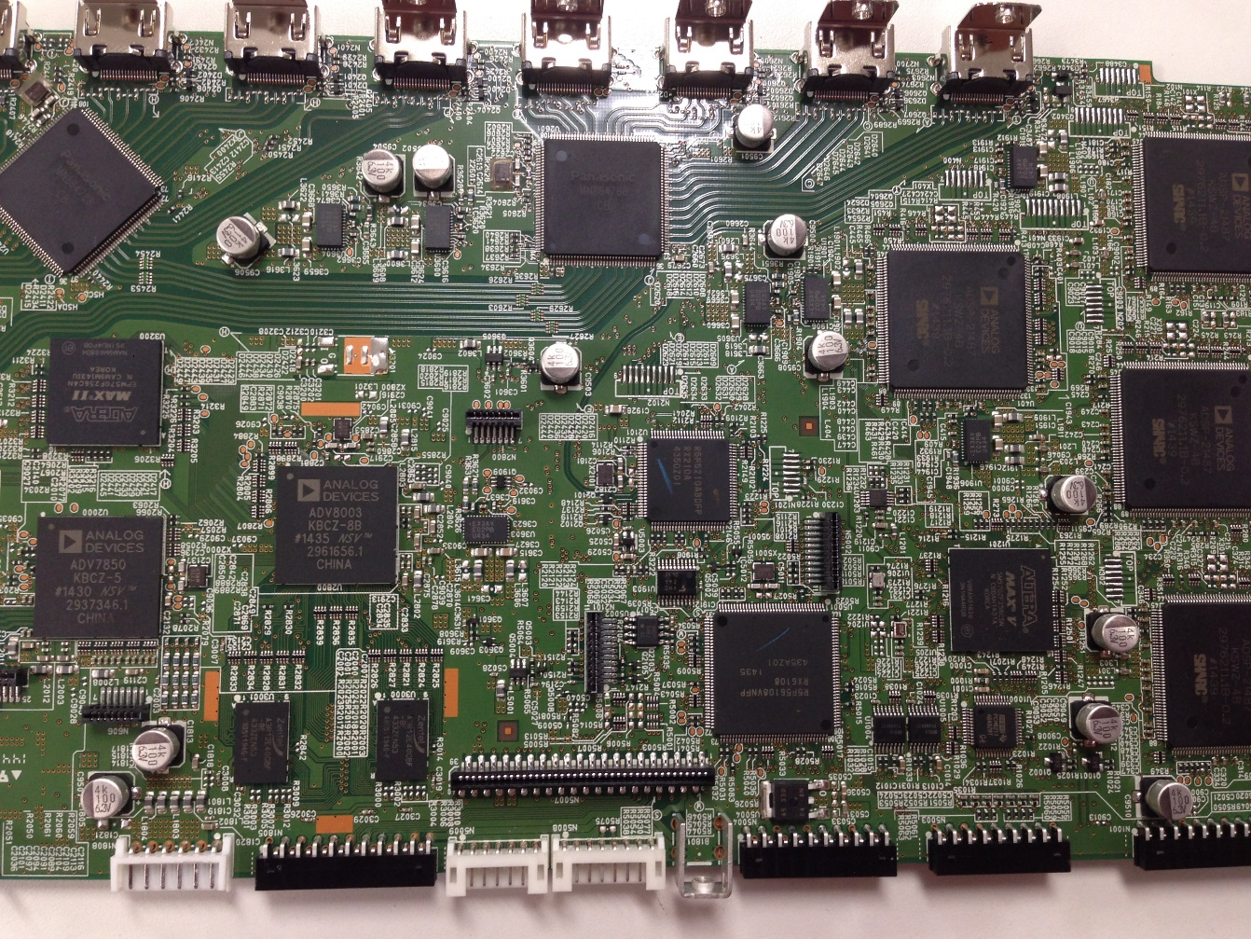
AV8802 HDMI PCB board
AV8802 has the feature parts for noise reduction and sound tuning
Only AV8802: 3terminals capacitors (Murata) around the DSP
Only AV8802: many capacitors (ELNA PCAP series) for sound tuning

Slide 4
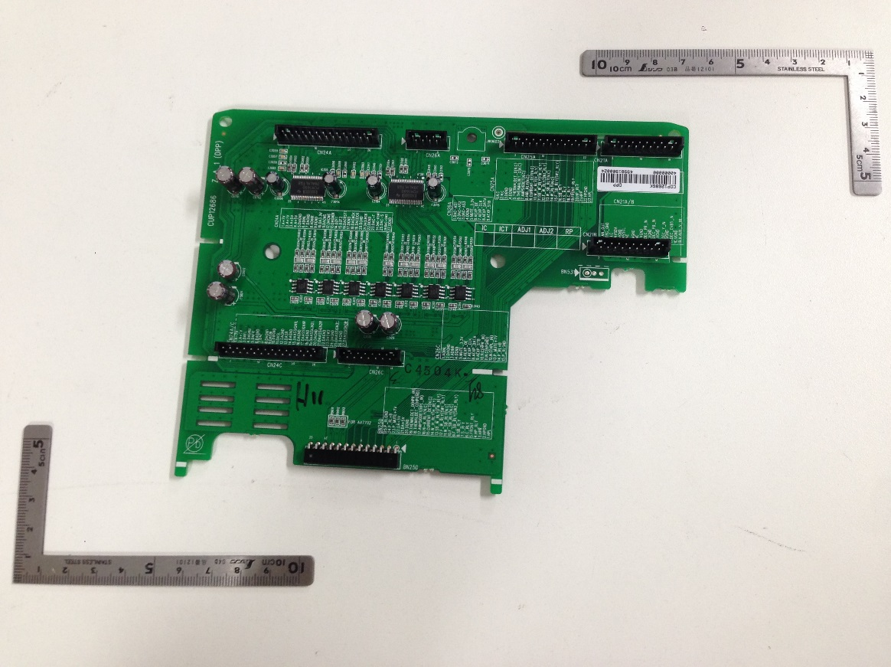
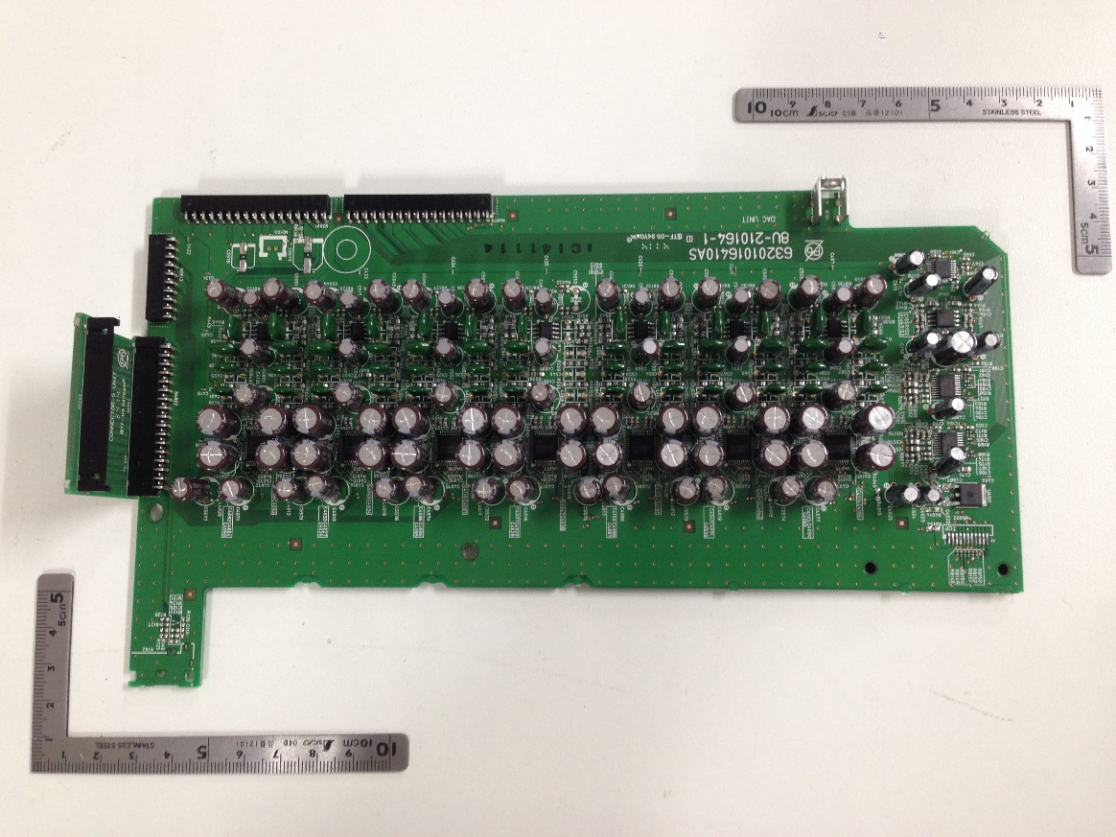
DAC PCB board
AV7702: PCM1690 8ch ×2pcs
AV8802: AK4490 2ch ×7pcs

Slide 5
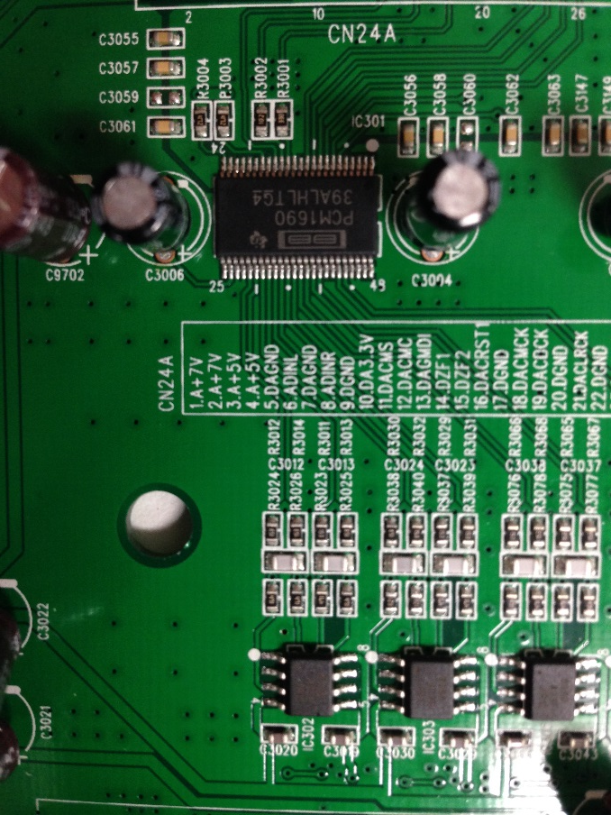
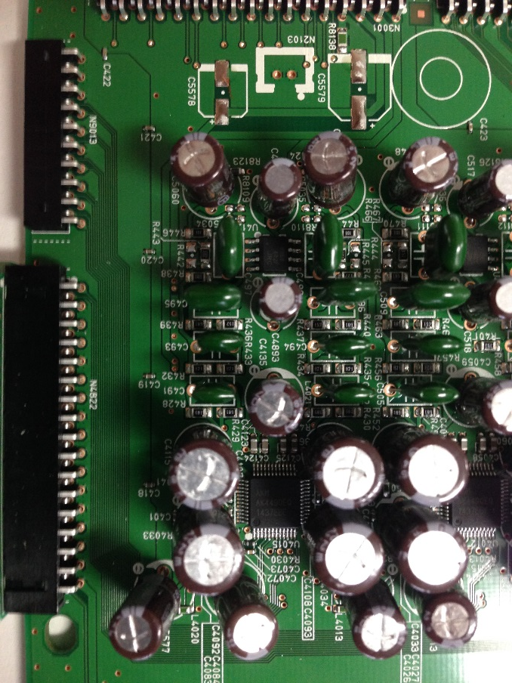
DAC PCB board
We can find a plenty of capacitor on AV8802
AV7702: PCM1690 2ch
AV8802: AK4490 2ch

Slide 6
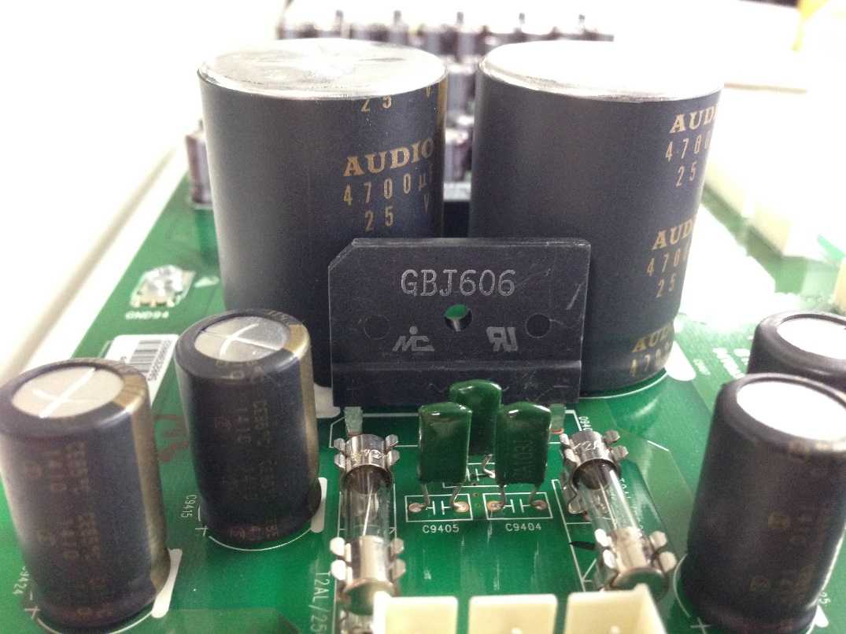
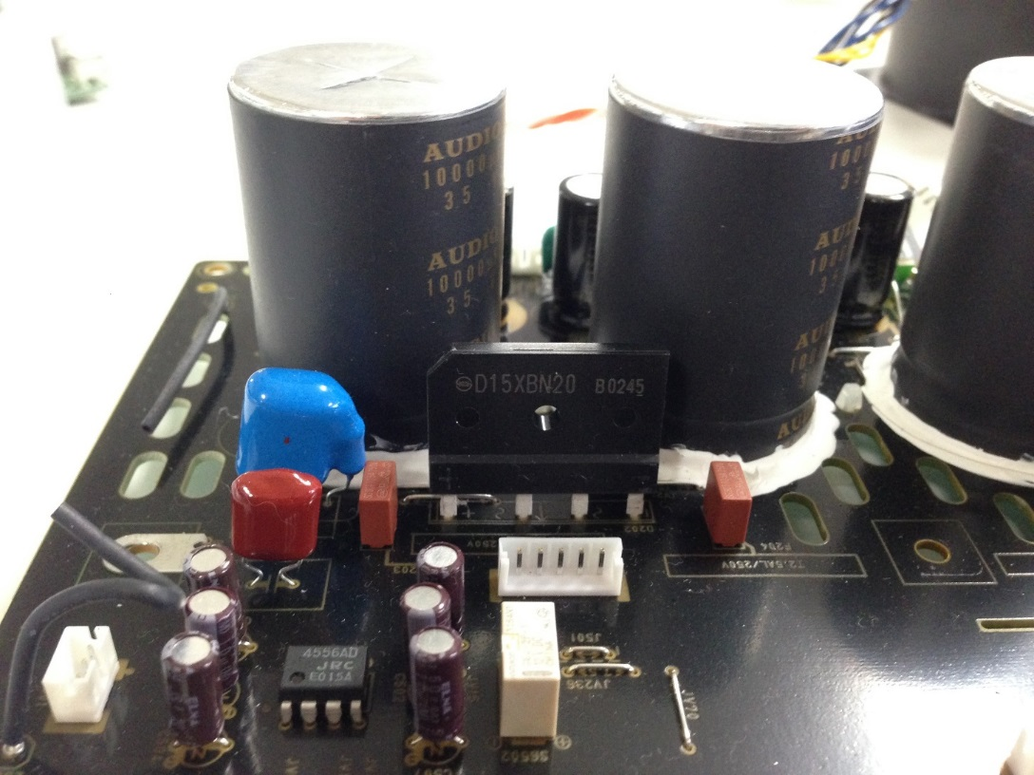
Rectifier diode
AV7702: PN junction diode
AV8802: Schottkey barrier diode

Slide 7
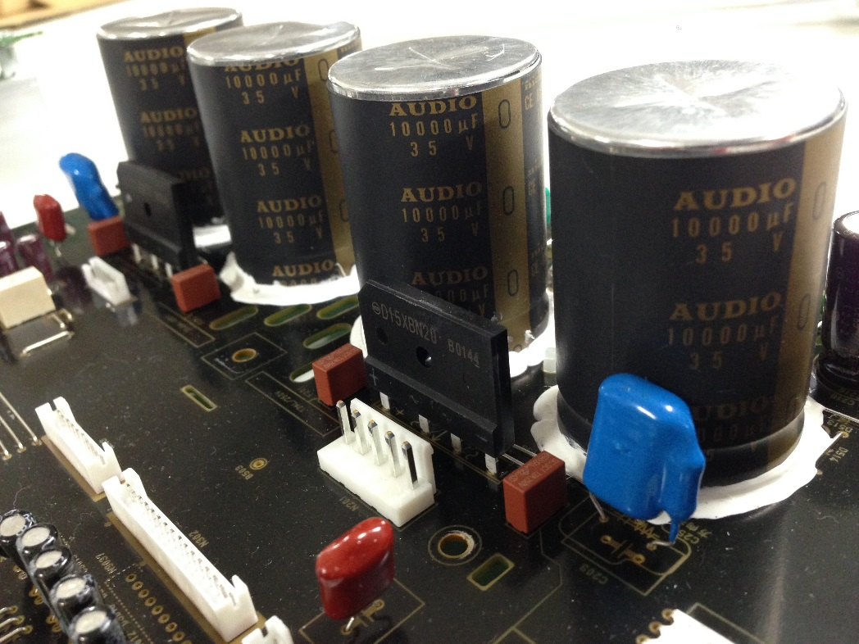
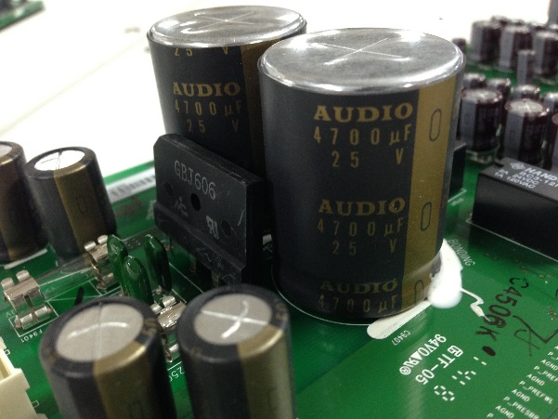
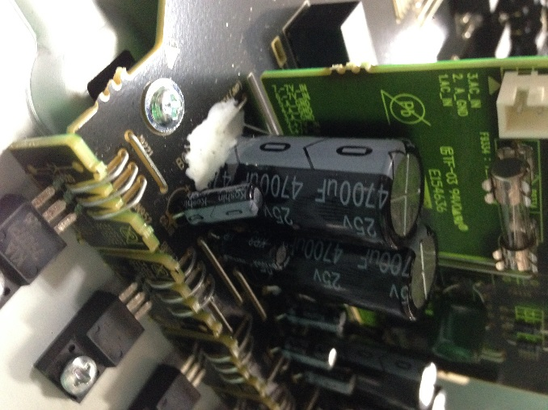
Power supply for Volume and HDAM
IMPORTANT: Additionally the 8802 Doubled the Capacitance In Comparison to the 8801. The Cap’s are also Higher Grade.
AV7702: 4700uF/25V(φ16×L30) ×2pcs for Volume
4700uF/25V(φ30×L40) ×2pcs for HDAM
AV8802: 10000uF/35V(φ35×L50) ×4pcs

