Slide 1

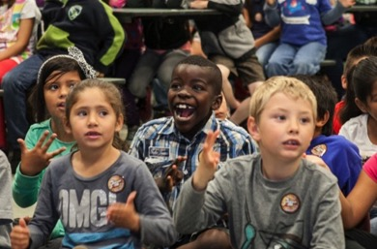
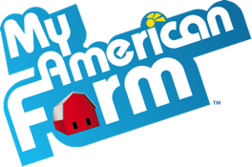
My American Farm in the Classroom
DISCOVER
THE FUN!
#WeTeachMyAmericanFarm
1

Slide 2

Needs Assessment
It’s about life
Answer It: What do people need to survive?
List the top 10 things that come to mind.
Share it: Share with a partner.
Narrow down your lists to no more than 5 items.
Let’s hear it!
2

Slide 3


Needs Assessment
THIS IS...
Let’s get real
AWESOME!!!
What do your (future) students need more of?
What do you need more of?
Let’s hear it!
3

Slide 4
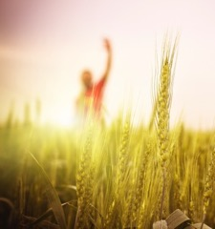

It’s Why We’re Here
The Easy Button
Agriculture is vital to life.
You are expected to meet standards.
Food and fiber literacy is great for learning!
So why are YOU here?
What motivated you to attend?
What do you hope to take away?
GET READY TO
LET LOOSE AND
LAUGH AND PLAY!
4

Slide 5
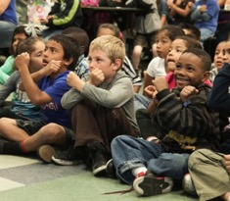

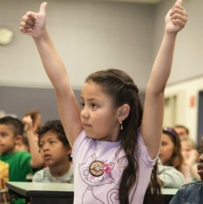
Let’s Play
www.myamericanfarm.org
GET READY TO
LET LOOSE AND
LAUGH AND PLAY!
5
Notes:
Game image linked to http://myamericanfarm.org/games/fairy_tale/

Slide 6
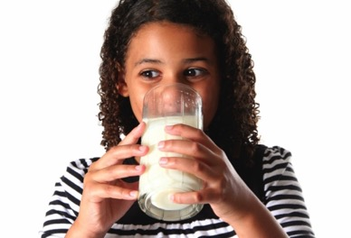
Crash Course in Food and Fiber Literacy
6

Slide 7
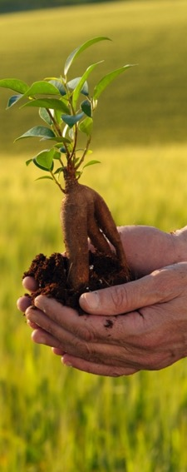
Crash Course
What’s on your mind?
What do we know about American agriculture?
What do we want to know?
What might our students be curious about, with regard to where their food comes from?
7

Slide 8
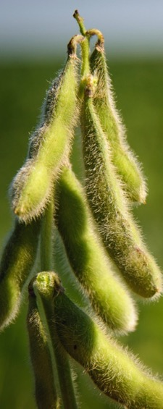
What is agriculture?
Crash Course
Agriculture is the term that encompasses all of the industries and processes involved in the production and delivery of food, fiber and fuel.
8

Slide 9
What is the scope?
Crash Course
2
% of US population made up of farmers and ranchers
Farmers and ranchers are diverse, growing conventional, biotech and organic crops.
3.2
Million U.S. farm operators
Spanish, Hispanic, Latino 99,734
African American 44,629
American Indian 58,475
Women 969,762
97
% of U.S. farms owned by FAMILIES
3% owned by non-family corporations
9

Slide 10
What is the scope?
Crash Course
17
Cents of every dollar that goes to farmers
83%, on average, goes to off-farm costs, like marketing, distributing and retailing.
169
People fed by each U.S. farm family annually
America’s farms and farmers are the world’s most productive.
87
% of U.S. production that is crops
13% of production (by weight) is livestock.
10

Slide 11
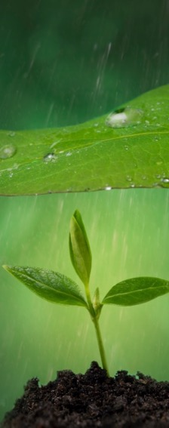
What is the scope?
Crash Course
Farmers take land stewardship seriously.
50% decline in erosion of cropland by wind and water since 1982
U.S. farmers and ranchers are innovative.
Production varies across the country based on geography and climate.
11

Slide 12
So what?
Why should I, or my students, care?
We only have to spend10% of our disposable income on food!
New Zealand: 13%
Venezuela: 20%
India:
30%
Kenya:
47%
98% of us are disconnected!
Agriculture = Food and Fiber Literacy for Life
Healthy Habits
Safe Food Prep
Know where food comes from
12

Slide 13
Let’s talk careers
For your students
Agribusiness
Animal Systems
Environmental Service
Food Products & Processing
Natural Resources
Plant Systems
Power, Structural & Technical Systems
7K jobs available in ag RIGHT NOW!
agcareers.com
13

Slide 14
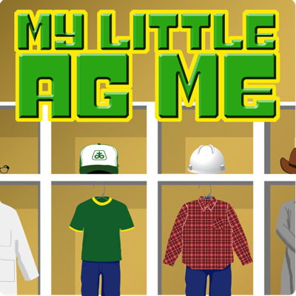
Let’s Play
www.myamericanfarm.org
GET READY TO
LET LOOSE AND
LAUGH AND PLAY!
14
Notes:
Game image linked to http://myamericanfarm.org/games/my_little_ag_me/

Slide 15
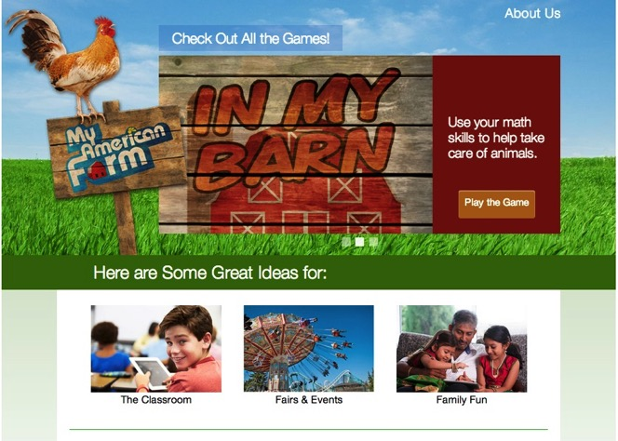
EXPLORING THE SITE
WWW.MYAMERICANFARM.ORG
Farmers feed the world
Farmers care for animals
Farmers steward the land
Agriculture is everywhere
Careers in agriculture
15

Slide 16
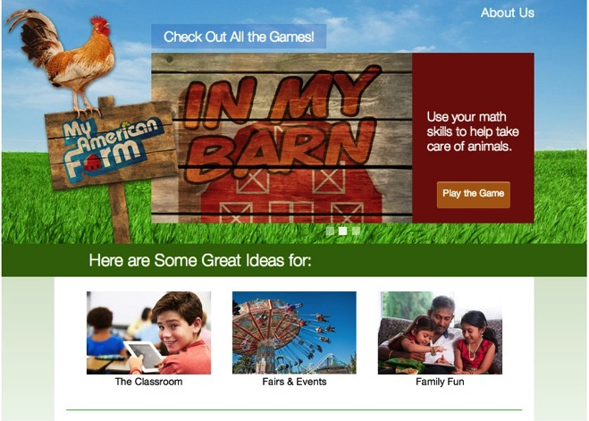
EXPLORING THE SITE
WWW.MYAMERICANFARM.ORG
16

Slide 17






EXPLORING THE SITE
WWW.MYAMERICANFARM.ORG
17
Notes:
NOTE: You may prefer to walk through the site navigation using the online resource as opposed to these slides.

Slide 18
Let’s Try It
www.myamericanfarm.org
Explore and find for your grade level:
1 Game
1 Lesson Plan
1 Activity Sheet
Be ready to share!
GET READY TO
LET LOOSE AND
LAUGH AND PLAY!
18
Notes:
Game image linked to http://myamericanfarm.org/games/fairy_tale/

Slide 19
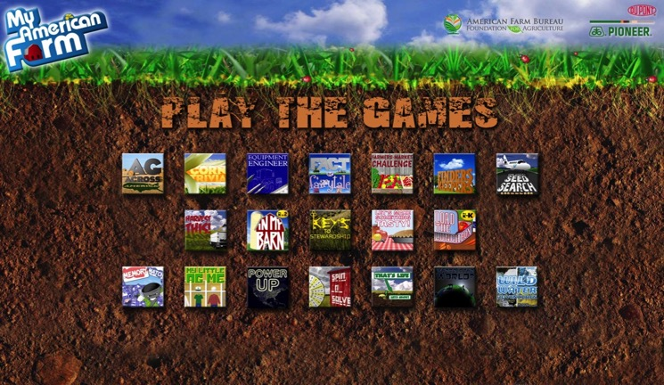
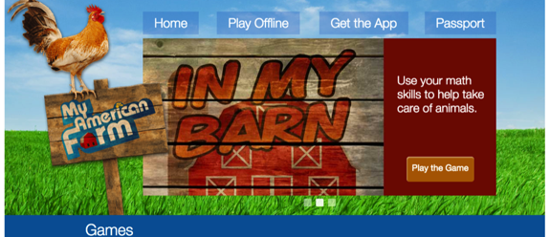
Tech Tools
Offline kiosk version
19

Slide 20

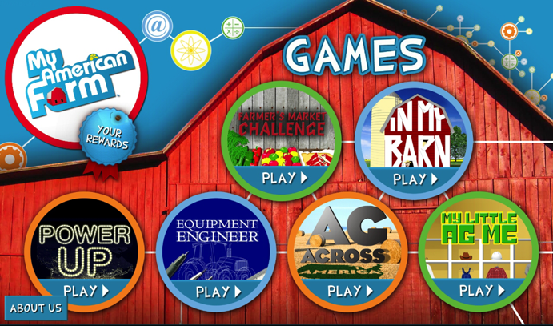

Tech Tools
My American Farm Tablet App
20
Notes:
Note that this is for tablet only, not smartphone.

Slide 21


Tech Tools
All about beef phone/Tablet App
21
Notes:
Note that this is for tablet only, not smartphone.

Slide 22
Let’s Try It
How would YOU use it?
Seed starter lesson
Build it: 1 glove, 5 seeds, 5 cotton balls, 1 ribbon
Process it: What would you ask?
What do most seeds need to grow?
What can you do to care for your seeds?
What do farmers do to care for their seeds?
GET READY TO
LET LOOSE AND
LAUGH AND PLAY!
22
Notes:
Game image linked to http://myamericanfarm.org/games/fairy_tale/

Slide 23
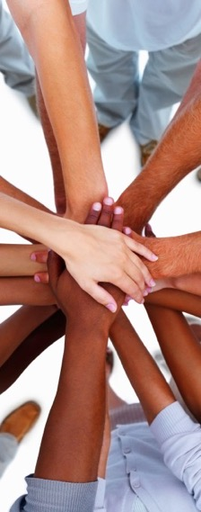
Let’s build a team
We’re in this together!
Local Contacts:
TBD
TBD
TBD
My American Farm or American Farm Bureau Foundation Questions:
Angela Mayfield educationdirector@fb.org
23

Slide 24

Brought to you By
24

Slide 25
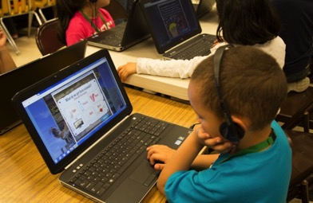
My AmericAn Farm in the Classroom
DISCOVER
THE FUN!
#WeTeachMyAmericanFarm
25

