Slide 1
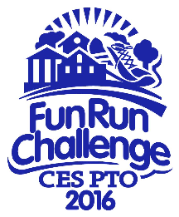
Chester Elementary School PTO Presents
Saturday
April 9th, 2016
at
Chester Elementary School
9 AM – 12 PM
(rain date April 10th)
Bring a water bottle!
CES PTO is pleased to announce its third annual Fun Run Challenge open to all CES students. This year’s event takes on a whole new flare with challenging obstacles that participants can navigate to test their physical ability at their own pace. The goal is to provide a fun & healthy event for kids while raising funds to help support the many activities and services the PTO provides.
All participants will receive a t-shirt
K-2 students must be accompanied by an adult through the course.
Collect sponsors for completed challenges and every $25 raised will enter you into a drawing for prizes.
The top three money raising classes get a Smoothie Party!
Sponsor money due April 15th
Drawing will be held on April 22nd
Check-in starts at 9AM. Group Stretch starts at 9:15
Send registration and sponsor money in with child – label it “PTO Fun Run”
Registration/Waiver must be received by Monday 3/21

