Slide 1
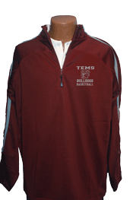
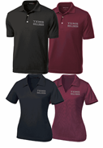
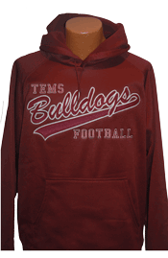
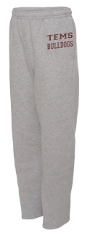
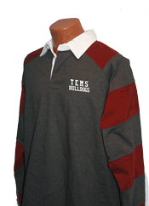
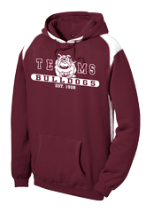
TEMS SPIRIT WEAR
Special 15% discount on flannel Spirit Wear in time for the holiday season*. Please order online** at http://www.temspto.org or return this form to the office with cash or check no later than Tuesday, December, 15th for free shipping or for special flannel pricing. Orders should be delivered to the office by December 21st. Please contact lchambers@ti.com with any questions.
Student Name _____________________ Grade ____ Parent email:_____________________________
$20
Ladies
AS ______ AL ______
AM ______ AXL ______
Mens
AS ______ AL ______
AM ______ AXL ______
Others sizes and colors available online
$45
AS ______ AL ______
AM ______ AXL ______
Want # on sleeve? +$5 #______
Want sport name on front? +$5
Indicate sport. ___________________
$36
YM ______ YL ______
YXL ______
AS ______ AL ______
AM ______ AXL ______
$35
YS ______ YL ______
YM ______ YXL ______
AS ______ AL ______
AM ______ AXL ______
$26
YS ______ YL ______
YM ______ YXL ______
AS ______ AL ______
AM ______ AXL ______
$48
AS ______ AL ______
AM ______ AXL ______
Want # on sleeve? +$5
#_____
*Enter the coupon code TEMSPROMO (all caps) at checkout for your 15% discount if ordering a flannel item online.
**If you want your online order delivered to the office, select the Pick Up option.

Slide 2
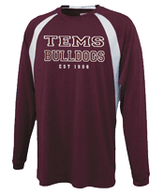
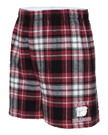
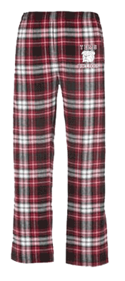
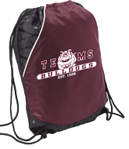

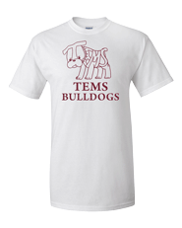
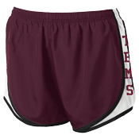
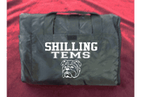
$25.10
Flannel pants (normally $30)
AS ______ AL ______
AM ______ AXL ______
$25
YS ______ YL ______
YM ______ YXL ______
AS ______ AL ______
AM ______ AXL ______
$12.75
(normally $15)
YS ______ YL ______
YM ______ YXL ______
AS ______ AL ______
AM ______ AXL ______
$15
__________
$20 (girl/lady sizes only)
YS ______ YL ______
YM ______ YXL ______
AS ______ AL ______
AM ______ AXL ______
$15
YS ______ YL ______
YM ______ YXL ______
AS ______ AL ______
AM ______ AXL ______
$10
YS ______ YL ______
YM ______ YXL ______
AS ______ AL ______
AM ______ AXL ______
$25
spectator blanket
__________
You can learn more about each item & order on-line. Go to TEMSPTO.ORG
You can learn more about each item & order on-line. Go to TEMSPTO.ORG

