Slide 1

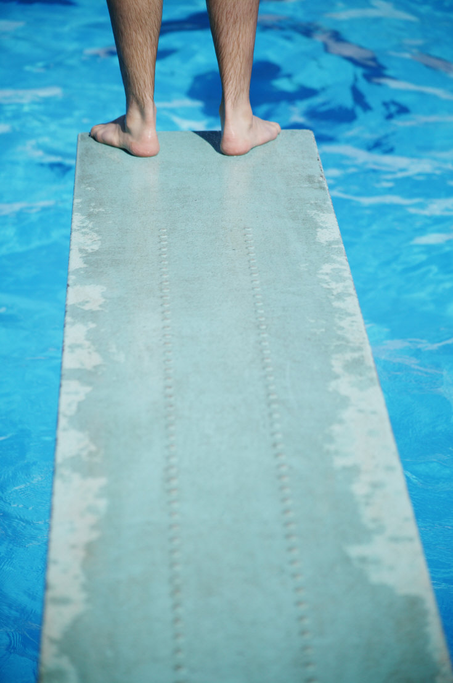
2016 Trout Valley
Pool Calendar
May 20 Guard Meeting @ Henderson Home 6:30 PM
May 21 Pool Clean Up & Scrub down 11:00-3:00 PM
May 22 Pool Clean Up & Set up 1:00-4:00 PM
May 27 Lifeguard meeting—Pool side 4:00 PM
May 28 Pool Opens for Season 12:00 NOON
May 29 Memorial Day Brunch Pool Opener 12:00 NOON
Bring a dish to pass- Open to ALL TV Residents
June 6 Water Aerobic Classes 9:00 AM M,W,F
June 12 Last Day to sign up for Pool
Membership before late fee is assigned
June 26 TV 4th of July ‘Leftovers’ Continued Poolside
July TBD Pool Olympics 11:00 AM
July 23 3rd Annual Bob Chinn Dinner Party 6:30 PM
Aug 6 Gutter Ball Tournament 10:00 AM
Sept 4 Labor Day Weekend Grill Out BYOB 12:00 NOON
Sept 5 Last Official Day Pool is Open with Lifeguards
________LOOK FOR OTHER SUMMER EVENTS TBA___________
**Dive-In Theater Kid Movie Night
**“Steak Out” ,“Chicken Out”, “Get Sauced”
-Family Style Theme Dinners Poolside
**Chick Flick Movie Night
**Karaoke Night

