Slide 1
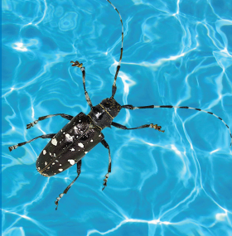

Thank you for protecting New York’s forests by participating in the 2016 Asian Longhorned Beetle Pool Survey!!
The Asian longhorned beetle (ALB) is an invasive insect from Asia that has been responsible for the loss of thousands of trees in the United States. We need many people looking for it to help stop it’s spread.
This survey is easy and takes little time. Just follow the instructions on the next page.

Slide 2
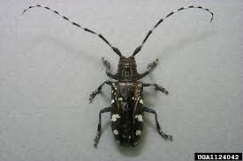
HOW TO COMPLETE THE SURVEY
STEP 1
From late-July until late-August, look at the debris you collect in your pool filter.
STEP 2
Look for ALB. Use the info on the next page to know what to look for. ALB is in the family Cerambycidae, the longhorned beetles, and their shape is easy to distinguish from other common insects.
STEP 3
Take a photo of any insect you think is ALB. We need a good view of the insect’s back. Here is an example.
STEP 4
As often as you can, send a photo of any insect you think might be ALB. There are 3 options for this step:
Send an email to foresthealth@dec.ny.gov with the subject heading ALB Pool Survey
Text image to (518) 810-1609, and please provide your name.
Send a physical copy of the image to the Forest Health Diagnostic Lab at 108 Game Farm Rd., Delmar, NY 12054
STEP 5
Freeze the insect you photographed in a zip loc bag or Tupperware container until you hear back from us.

Slide 3
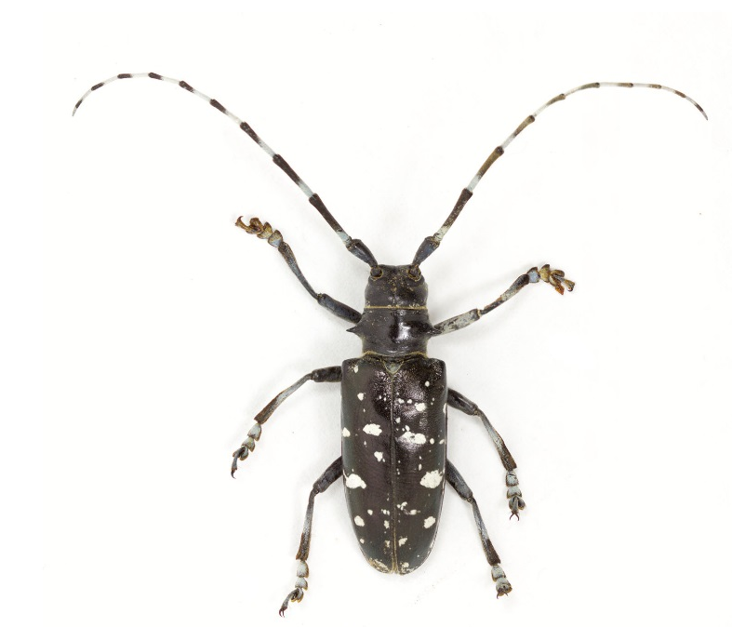
IDENTIFYING THE BEETLE
ALB’s physical characteristics:
1
The beetle has two long, black-and-white antennae.
2
2
It’s shiny, with a black body and white spots.
3
It has six legs.
4
Body is 1 inch to 1.5 inches.

Slide 4
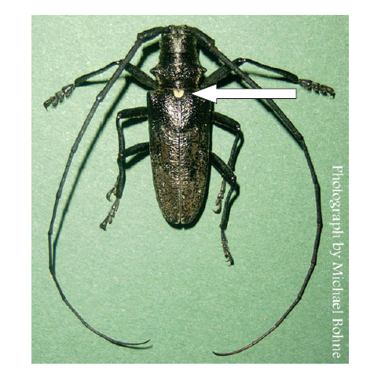
ALB vs. White-Spotted Sawyer
The white-spotted pine sawyer beetle is native to this region and feeds on dead and dying pine trees, not live hardwoods. It has a small white spot where the two wing pads come together (see arrow). Some have white blotches and others are mostly blackish.

Slide 5
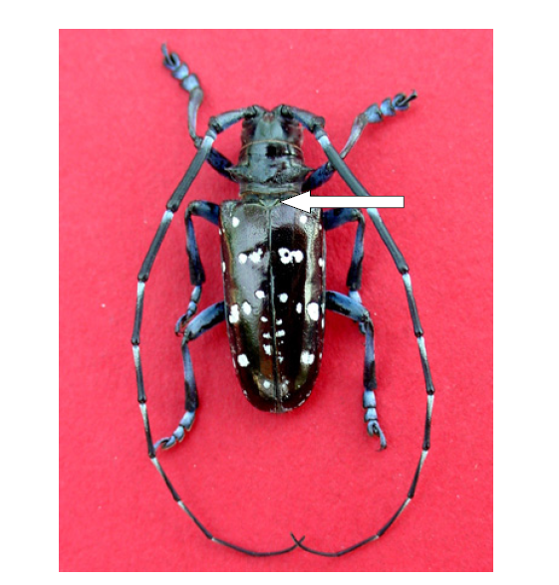
ALB vs. White-Spotted Sawyer
The Asian longhorned beetle is shiny black, with bright white irregular spots, but lacks the one small white spot found on the whitespotted sawyer (see arrow).

Slide 6
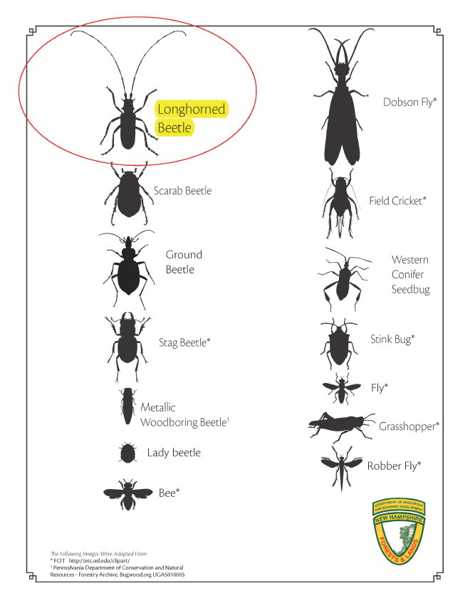

SILHOUETTES OF COMMON INSECTS

Slide 7
What’s next?
We will send you occasional reports on what we are finding and will include interesting photos.
If you have any questions, please contact:
Jessica Cancelliere @ foresthealth@dec.ny.gov or call (518) 478-7813.
Thanks again, and happy hunting!!

